Slide 1
Expansion temperature measurements
Rijk Hogenbirk
05/12/2019

Slide 2
Content
After the first expansion measurements, where the pressure in the main chamber is measured after prepping the hydrogen and air chambers with a certain pressure and expanding that gas into the mixing and main chamber, I tried calculate the unknown volumes (Vpc and Vvalve), but one of them (Vvalve) turned out negative.
The values themselves seemed reasonable though
Vvalve = -0.215L and Vpc = 0.422L
For this calculation I used that PV=constant, but this is only the case if the temperature of the gas is conserved. But as the temperature of expanding gas decreases, this cannot be used. But if the temperature of the expanded gas is measured, then this can be taken into account and the unknown volumes can be calculated.
Therefore I put a Pt1000 in a chamber (with a different volume from the main chamber) to measure this temperature.
The first slide shows an expansion measurement as performed before, the second and third slides show measurements that simply let air into the vacuum pumped chamber. Pt1000 is measured with the Lakeshore TC

Slide 3
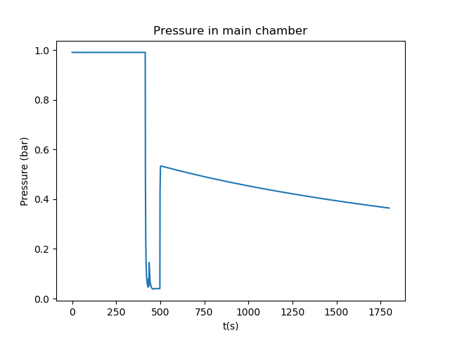
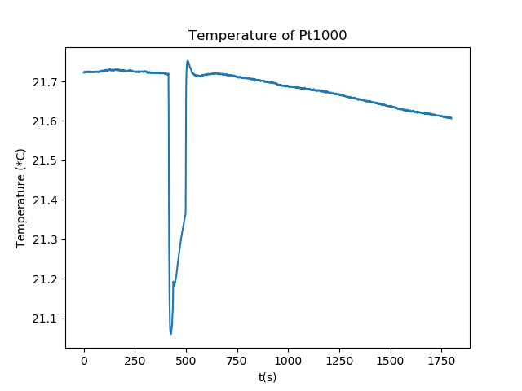
Expansion into Main chamber
Temperature briefly drops when vacuum is applied, then heats up when air enters the chamber and finally slowly lowers again. Might be because the chamber walls are colder than the air (?) and the Pt1000 makes contact with the wall.
1205_1404_expansiontemp_test_static

Slide 4
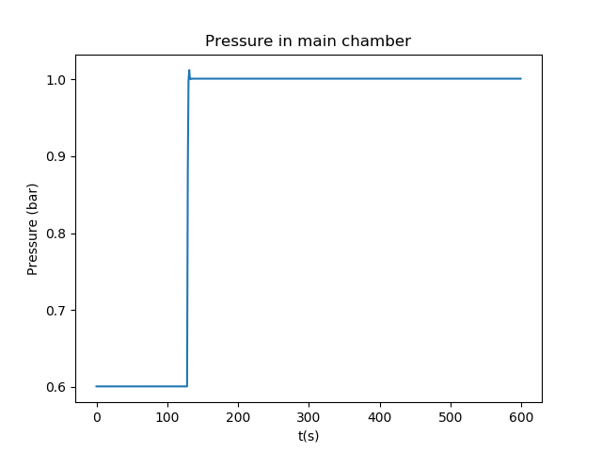
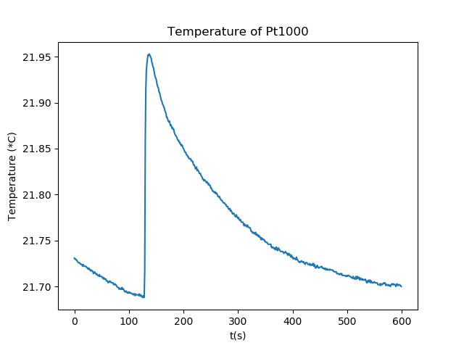
Letting in Air into chamber from vacuum
1205_1532_expansion_temp_test_increaseP_2

Slide 5
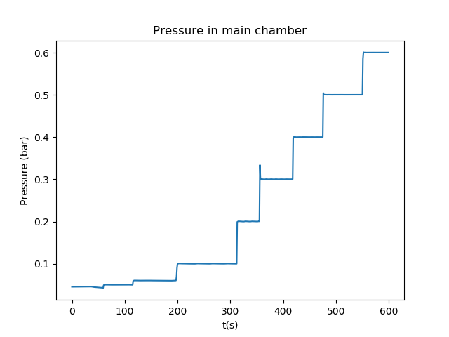
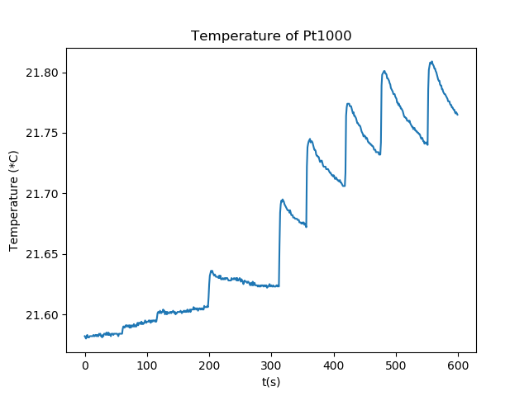
Letting in Air in steps
1205_1521_expansion_temp_test_increaseP

